Slide 1

1 - Spring Scale
Procedure:
A spring scale was suspended by hand or using a retort stand and clamp
Force measurements were taken for several small mass increments
Draw a FBD for your experiment
Provide a data table for your measurements
Confirm that the relation F = ma is valid and linear
Find an experimental value for “a” (a = g = 9.81 m/s²).

Slide 2
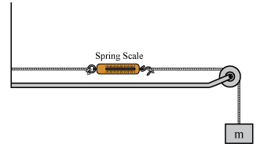
2 - Pulley
Procedure:
A spring scale was configured using a pulley and string as shown in the diagram
Force measurements were taken for a 100g and 200g mass
Draw a FBD for your experiment
Predict the force measurements that will result for each mass
Test your prediction and report your results
Provide a conclusion that explains your results.

Slide 3
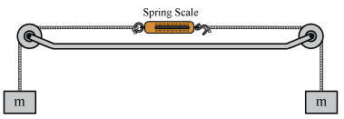
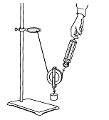
3 - Advanced Pulley
Procedure:
A spring scale was configured using a pulley and string as shown in the two diagrams
Force measurements were taken for a 200g mass
Draw a FBD for your experiment
Predict the force measurements that will result for each configuration
Test your predictions and report your results for each configuration
Provide a conclusion that explains your results for each configuration

